Slide 1

AccuTrack
NURTURING A HEALTHY WORKFORCE

Slide 2
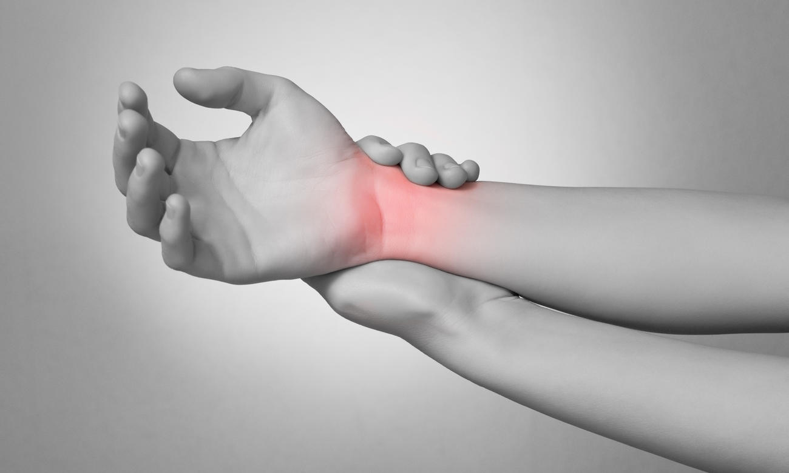
1.8 MILLION
ERGONOMIC INJURIES
IN THE UNITED STATES
EVERY YEAR

Slide 3



EXISTING SOLUTIONS
$10 BILLION
LOST IN PRODUCTIVITY
AND WAGES
EVERY YEAR

Slide 4


ACCUTRACK MICROCONTROLLER
CLOUD
PIPELINE
MOBILE
NETWORK
FLEX SENSOR

Slide 5
<LIVE DEMONSTRATION>

Slide 6
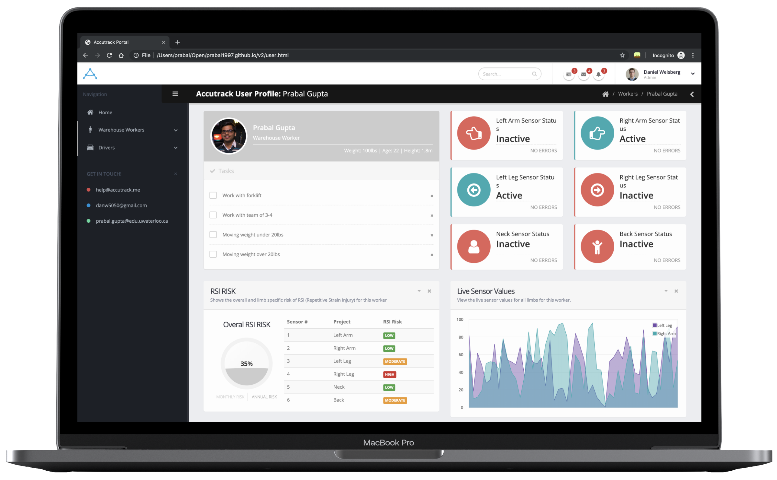

Slide 7
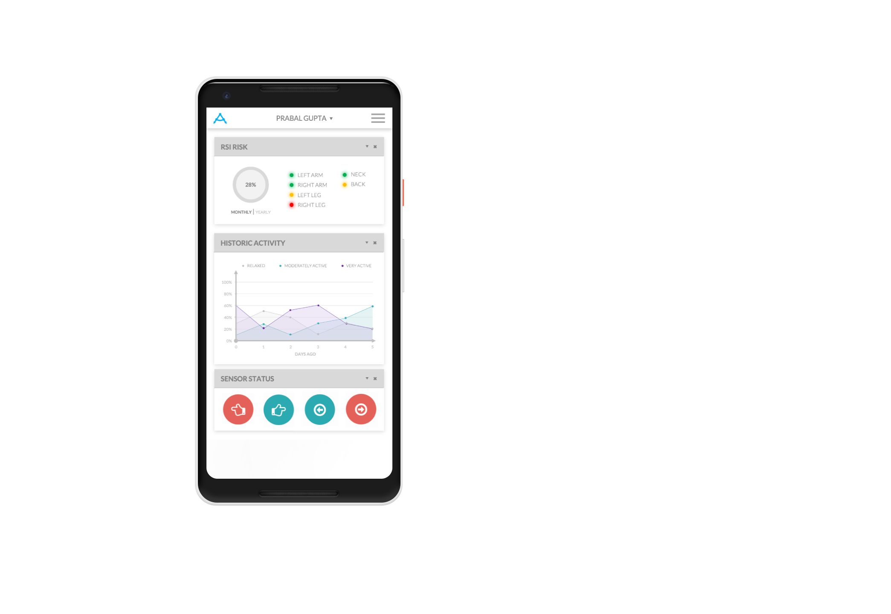
3
4
1
2

Slide 8




MOBILE
NETWORK
DATA
PIPELINE
AZURE
FUNCTIONS
AZURE
MACHINE
AZURE
ANALYTICS
NOTIFICATIONS
LEARNING
DATABASE
WEB PORTAL
HUB
PIPELINE
(APP SERVICE)

Slide 9
25¢
$12
OPERATIONAL
PRODUCTION
COST PER DEVICE
COST PER DEVICE
ON DAILY BASIS

Slide 10


DR. CARL HAAS
INTERIM CHAIR, PROFESSOR,
CANADA RESEARCH CHAIR

